Slide 1
The Entity Framework
Chapter 15

Slide 2
Chapter Overview
Objectives
To give an introduction to Entity Framework
Chapter content
The main features of Entity Framework
Database / Model / Code First / Code First from Database
Lazy / Eager / Explicit loading
Linq To Entities
Initialization and Migration

Slide 3
Why have an ORM at all?
Most applications use OO code and store in relational data hence there is a mis-match. To do-it-yourself you need to handle :
Write the object model
Write the plumbing code - synchronizing, lazy loading, persistence, track changes, concurrency, validation, data type conversions, relationships and associations, vendor independence, make it a LINQ-provider.
Typically the DIY way consumes ~35% of project code & budget. With an ORM this typically drops to <10%.

Slide 4
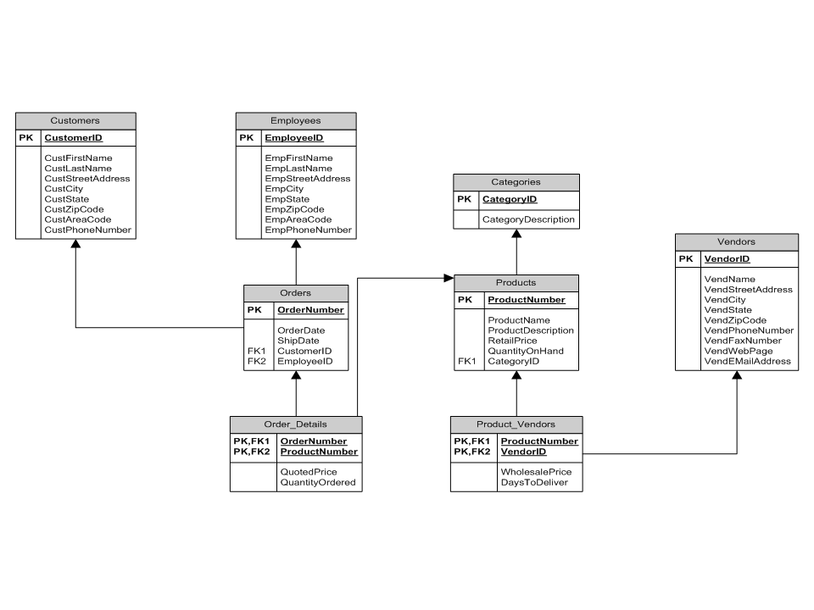
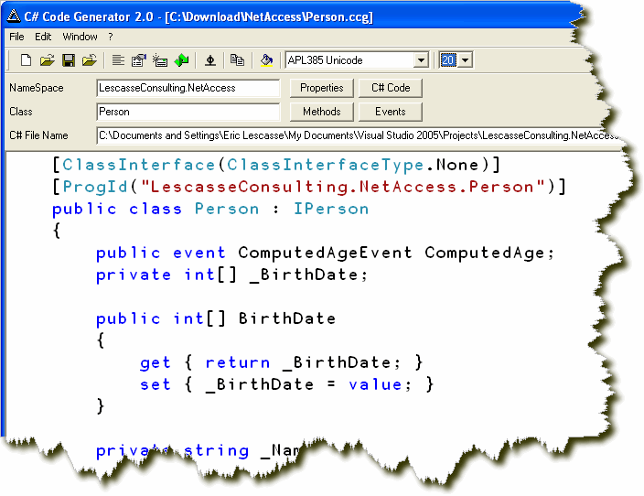
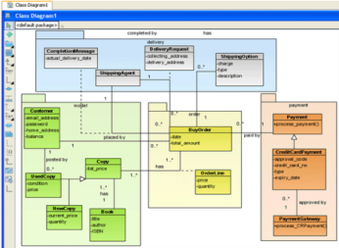
Code First
We use this process on this course
Schema
Database
Possible annotations to control DDL
Code
Class Diagram

Slide 5
Code First From Database
Possible ‘Buddy’ classes to add annotations
Schema
Database
Code
Class Diagram

Slide 6
To get started
EF favours convention
But almost everything can be modified by configuration
‘NuGet’
Microsoft.EntityFramework.Core.SqlServer
The minimum you need are
Properties NOT Fields!!
An Id Property
A Context
What provider
What database name, permissions etc
What database tables will be exposed to the code

Slide 7
Code samples for getting started
Properties and Ids
Context
public class Zoo {
public int ZooId { get; set; }
public string Name { get; set; }
}
public class ZooContext : DbContext {
public DbSet<Zoo> Zoos { get; set; }
public DbSet<Animal> Animals { get; set; }
}

Slide 8
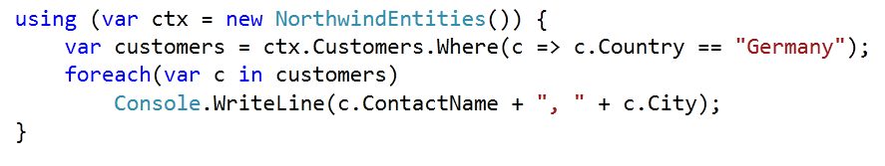
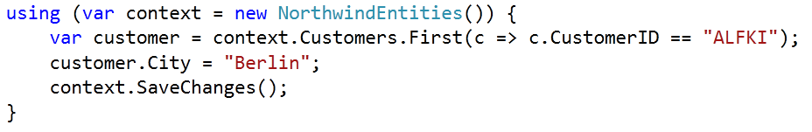
Using LINQToEntities
A regular ‘Select’
Change property and save

Slide 9
LINQ
Lambda-style
Query Expression Style
var customers = from c in ctx.Customers
where c.Country == "Germany"
select c;
foreach(var c in customers)
Console.WriteLine(c.ContactName + ", " + c.City);

Slide 10
Lambda expressions
ctx.Customers.Where(c=>c.Country == "Germany")
The above is really a sort of shorthand for this
...
var x = ctx.Customers.Where(GetABoolFromObject);
}
}
static bool GetABoolFromObject(Customer c) {
return c.Country == "Germany";
}

Slide 11
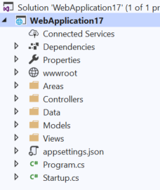
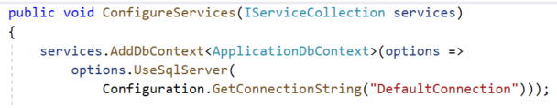
Configuration
Note the double-slash in json files
Notes:
The name of the database connection string can be passed into the DbContext constructor.
Note that newlines are not permitted in the connection string – this is done only so they can fit onto the page

Slide 12
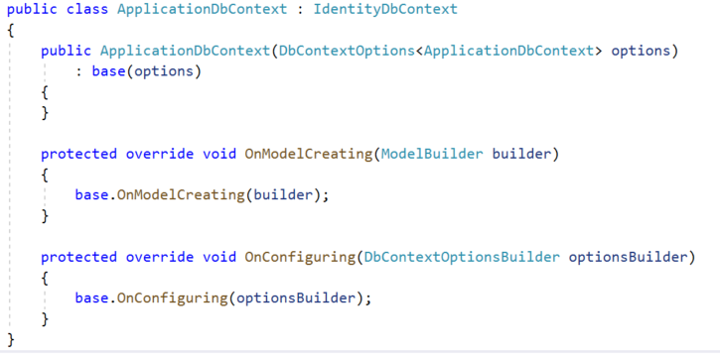
Context
Mandatory
Optional

Slide 13
Strategies for loading data
Lazy Loading
Principally for collections, but can be used for large fields
Loads the data on demand
Suitable when many usages of the parent data will not require the detail of the child data
Eager Loading
Suitable when the data is not huge and will very likely be needed shortly anyway
Explicit Loading
Suitable when you want to be in control over what is loaded when

Slide 14
Loading data in code
Lazy Loading
Eager Loading
Explicit Loading
public class Zoo {
public virtual ICollection<Animal> Animals { get; set; }
foreach (Zoo zoo in ctx.Zoos.Include(z=>z.Animals) ) {
ctx.Entry(zoo).Collection(z => z.Animals).Load();

Slide 15

Managing changes to schema
Migration
Preserves data
Needs to be actioned via the Package Manager Console
Enable-Migrations
Add-Migration “Initial”
Update-Database
Or
Update-Database -Script

Slide 16
Migration commands
Enable-Migrations:
Enables Code First Migrations in a project.
Adds the Migrations folder to the Project
Adds a configuration class to Migrations folder
Add-Migration:
Creates a new migration
Scaffolds a migration script to apply pending model changes
Contains version number
Update-Database:
Adds __MigrationHistory table to target database to track update history
Entity Framework compares model version with version in database. Applies the changes if needed
Get-Migrations:
Displays the migrations that have been applied to the target database.
Notes:
To deploy the database you'll use Code First Migrations. When you create the publish profile that you use to configure settings for deploying from Visual Studio, you'll select a check box labelled Execute Code First Migrations (runs on application start). This setting causes the deployment process to automatically configure the application Web.config file on the destination server so that Code First uses the MigrateDatabaseToLatestVersion initializer class.
Visual Studio doesn't do anything with the database during the deployment process while it is copying your project to the destination server. When you run the deployed application and it accesses the database for the first time after deployment, Code First checks if the database matches the data model. If there's a mismatch, Code First automatically creates the database (if it doesn't exist yet) or updates the database schema to the latest version (if a database exists but doesn't match the model).

Slide 17
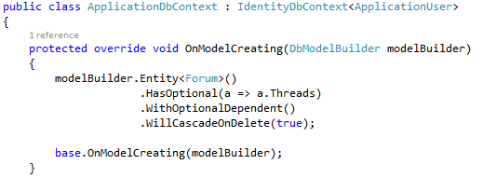
Configuration
Using Attributes
Using the Fluent API
[Required(ErrorMessage="Choose a forum for this thread")]
public int ForumID { get; set; }
[Column("OwnerID")]
public string UserID { get; set; }
Notes:
When working with Code First, you define your model by defining your domain CLR classes. By default, the Entity Framework uses the Code First conventions to map your classes to the database schema. If you use the Code First naming conventions, in most cases you can rely on Code First to set up relationships between your tables based on the foreign keys and navigation properties that you define on the classes. If you do not follow the conventions when defining your classes, or if you want to change the way the conventions work, you can use the fluent API or data annotations to configure your classes so Code First can map the relationships between your tables.

Slide 18
DbContext
If you use Migration, you may need to add this class that implements IDesignTimeDbContextFactory<YourContext>
There is an example of this in the lab

Slide 19
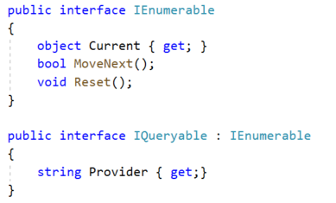
IEnumerable / IQueryable
IEnumerable allows you to iterate collections
IQueryable does the iteration but also allows you to pass commands (rather) than data across your application
Beware of multiple unintended database accesses
The general recommendation is to pass IList<> (ie an evaluated IEnumerable) as your interface

Slide 20
Further Entity Framework
Not covered in the course, but also present in the product :
Managing Inheritance
Using Stored Procedures
Script update of database
Managing Concurrency
Notes:
EF has 2 out-of-the-box strategies for managing inheritance – Table-Per-Hierarchy (the default) and Table-Per-Type.

Slide 21
Summary
Entity Framework is a World-Class ORM
Works by convention – which can be changed by configuration
Has strategies for loading data
Schema change handled by Migration
Handles inheritance, concurrency, stored procs etc

Slide 22
Hands On Labs
Get started with the Entity Framework Code First
Code First from Database (optional)
Create the QAForum app
Notes:
Resources:
https://learn.microsoft.com/en-gb/ef/ef6/?redirectedfrom=MSDN
https://www.learnentityframeworkcore.com/

